Slide 1

Computer Networks
Week # 01
M.Nadeem Akhtar
CS & IT Department
The University of Lahore
Email: nadeem.akhtar@cs.uol.edu.pk
URL-https://sites.google.com/site/nadeemuolcsccn/home
Powerpoint Templates

Slide 2
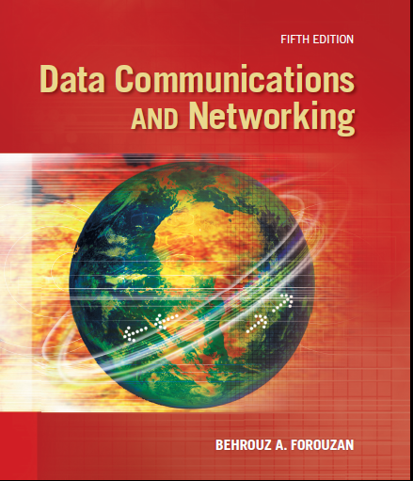
Recommended Text book
Book 1: Data Communications
and Networking, 5th edition
Author: Behrouz A. Forouzan

Slide 3
Reference books
Book 2: William Stallings, Data and Computer Communication, 8th or 9th Edt.
Book 3: Computer Networks by Andrew S. Tanenbaum and David J. Wetherall,
Prentice Hall; 5th Edition
Book 4: Computer Networks and Internets By Douglas E. Comer (5th Edition)

Slide 4
Grading Criteria
Assignments/Project [10%]
Quizzes [10%]
Midterm [20%]
Lab Tasks [20%]
Final Exam [40%]

Slide 5
Course Overview (1/4)
Topics that we are planning to cover:
Fundamentals of data communications & Networks
Network Models (System Architecture)
OSI
TCP/IP (in Detail)
Digital and analog data/signals
Transmission impairments
Channel Capacity
Signal to Noise ratio
Nyquist Bandwidth formula
Shannon’s channel capacity

Slide 6
Course Overview (2/4)
Topics that we are planning to cover:
Digital and Analog Transmissions
Modulation schemes
Data encoding schemes
Asynchronous and Synchronous transmission
Transmission Media
Guided Media
Unguided Media
Multiplexing
Switched and IP Networks
Circuit Switched Networks
Packet Switching
Structure of a Switch

Slide 7
Course Overview (3/4)
Topics that we are planning to cover:
Overview of
Wired (Ethernet) and
Wireless LANs
Data Link Layer
Functions of data link layer
Framing
MAC protocols
Error Control
Flow control
Bridging

Slide 8
Course Overview (4/4)
Topics that we are planning to cover:
Network Layer
Services & Performance
IPV4 Addresses
Network Layer Protocols (IP, ...)
Routing Protocols
Next Generation IP (IPv6)
Transport Layer Protocols (UDP,TCP, SCTP)
Application layer protocols
Lab exercises using packet tracer

Slide 9
ACKNOWLEDGMENTS
These lecture slides contain material from slides prepared by Behrouz Forouzan for his book Data Communication and Networking (4th/5th edition).

Slide 10
Week 1: Course Plan (1/2)
Fundamentals of data communications
Definition of Data Communication [Book1: 1.1]
Data Communication System
Characteristics [Book1: 1.1]
Components [Book1: 1.1.1]
Data Representation [Book1: 1.2]
Data Flow or Transmission modes [Book1: 1.3]

Slide 11
Week 1: Course Plan (2/2)
Fundamentals of Networks
Brief Intro to Networks [Book1: 1.2]
Computer Network Criteria [Book1: 1.2.1]
Network Applications
Physical structure of Networks [Book1: 1.2.2]
Based on type of Connection
Based on type of Topology

Slide 12
Data Communication (1/2)
“Data Communication is the exchange of information from one entity to the other using a transmission medium”.
As you can clearly notice, the definition of Data Communication, although simple, leaves many questions unanswered:
Exchange ??????
Information ?????
Entities ???????
Transmission ????
Medium ????

Slide 13
Data Communication (2/2)
When we communicate, we share information
Information sharing can be LOCAL or REMOTE
Between individuals
LOCAL communication occurs face to face
REMOTE communication occurs over a long distance
Telecommunication means communication at a distance: telephony, telegraph and television
Data refers to information presented in whatever form is agreed upon by the parties creating and using the data

Slide 14
Data Communication System
For Data Communication to occur
The communicating devices must be a part of a communication system made up of some specific kind of hardware (Physical equipment) and software (Programs),
This type of a system is known as a “Data Communication System”

Slide 15
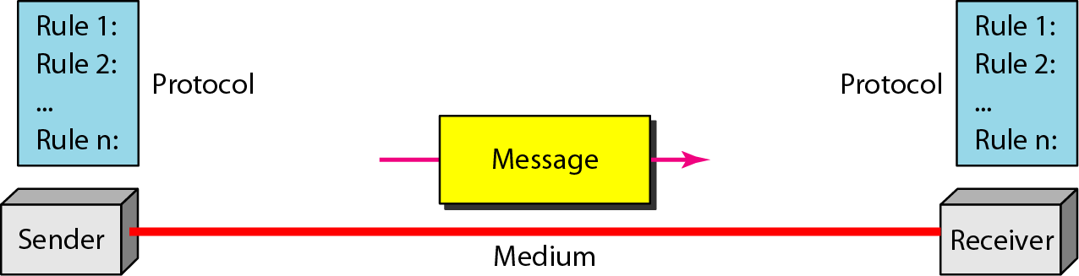
Components Of
Data Communication System (1/3)
Any system is made up of more than one component. Similarly, a data communication system is made up of 5 components:

Slide 16
Components Of
Data Communication System (2/3)
Sender is the device which sends the data messages. It can be a computer, workstation, telephone handset etc.
Receiver is the device which receives the data messages. It can be a computer, workstation, telephone handset etc.
Message is the information to be communicated. Popular forms of information include text, pictures, audio, video etc.
Protocol is a set of rules that governs the data communications.
It represents an agreement between the communicating devices.
Without a protocol, two devices may be connected but not communicating.
It determines what is communicated, how it is communicated and when it is communicated.

Slide 17
Components Of
Data Communication System (3/3)
Medium is the physical path by which a message travels from sender to receiver. Some examples include
Copper wire (Telephone)
Coaxial cable (Cable TV)
Fiber Optic Cable
Radio waves (known as wireless medium)
Data is required to be transferred in the form of electromagnetic (EM) signals
So medium should be able to carry the EM signals

Slide 18
Characteristics of
Data Communication System
The effectiveness of a data communications system depends on
Delivery of data to the correct destination
Accuracy: data must be delivered accurately (as it is)
Timeliness: data must be delivered on time
Real time transmission of audio and video data
A data communication system must transmit data to the correct destination in an accurate and timely manner

Slide 19
Data Representation (1/2)
Forms of Information
Text (represented as a bit pattern (0s or 1s))
Different set of bit patterns are designed to represent text symbols and each set is called a code
Coding: process of representing symbols
Currently prevailing Unicode system uses 32 bits to represent a symbol
ASCII constitutes of first 127 characters of Unicode
Numbers (represented as a bit pattern (0s or 1s))
A number is directly converted to a number to simplify math operations

Slide 20
Data Representation (2/2)
Forms of Information
Images (also represented by bit patterns)
Composed of a matrix of pixels (picture elements)
More pixels, better resolution, more memory
Each pixel is assigned a bit pattern
Audio
recording or broadcasting of sound or music
Different from text, numbers, or images (by nature )
Continuous, not discrete
Video
recording or broadcasting of a picture or movie
can either be produced as a continuous entity (e.g., by a TV camera), or
can be a combination of images, each a discrete entity, arranged to convey the idea of motion.
Can be changed to a digital or an analog signal

Slide 21
Data Flow (1/2)
Communication between two devices
Simplex
One way communication
One device can only transmit, other can only receive
Keyboards (introduces inputs), monitor (accepts output)
Use of entire capacity in one direction
Half-duplex
each station can both transmit and receive, but not at the same time
used in cases where there is no need for communication in both directions at the same time
Use of entire capacity for each direction
Walkie-Talkies

Slide 22
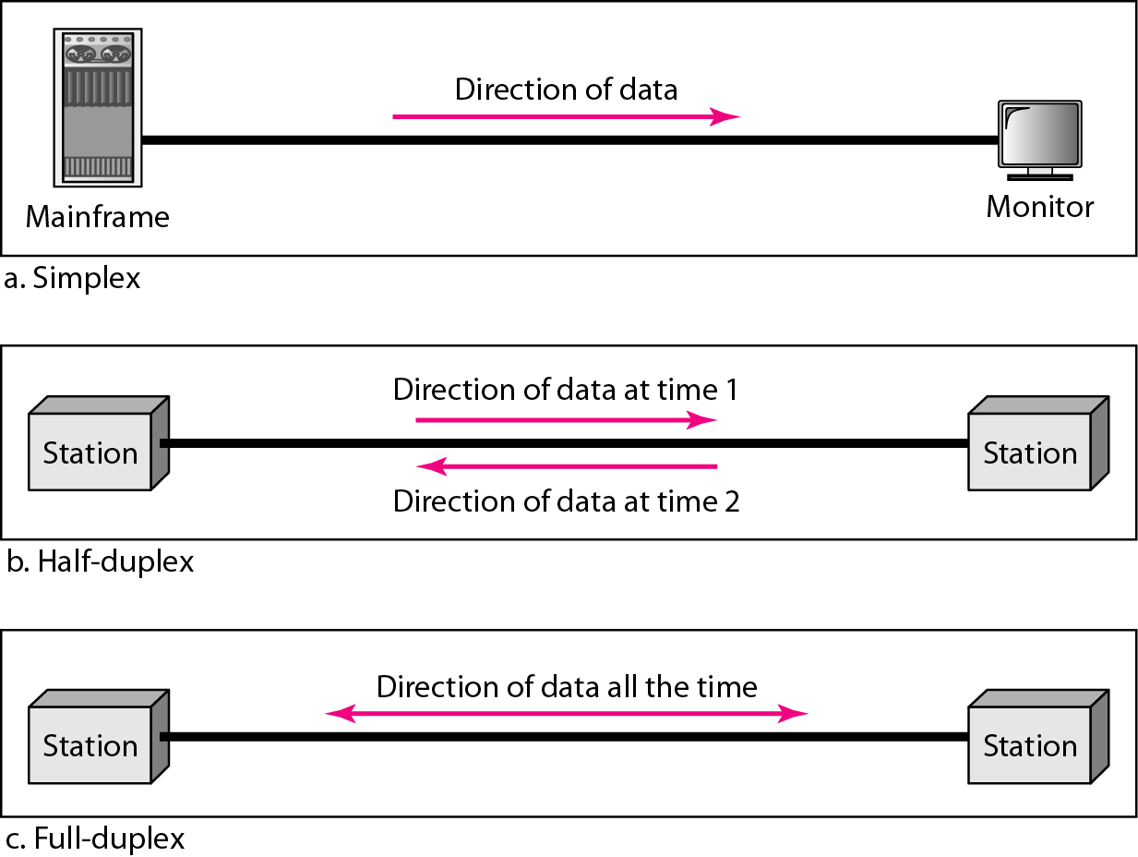
Data Flow (2/2)
Communication between two devices
Full-duplex
both stations can transmit and receive simultaneously
Sharing of capacity between signals in both directions
Used when communication in both directions is required
Telephone network

Slide 23
Computer Networks
Organization of computer systems is strongly influenced by the merging of computers and communications
The old model: a single computer serving all of the organization’s computational needs
replaced by one in which a large number of separate but interconnected computers do the job
These separate but interconnected computers are called computer networks

Slide 24
What is a network?
A network is a set of devices (often referred to as nodes) connected by communication transmission channels (links) that allow people to communicate over distances, large and small
In simple words, a network is the interconnection of a set of devices capable of communication

Slide 25
Computer Networks
Computer Networks: a collection of autonomous computers interconnected by a single technology
Two computers are said to be interconnected if they are able to exchange information
Networks are usually connected together to make larger networks (network of networks)
Internet: the most well-known example of a network of networks

Slide 26
Network Criteria (1/3)
Most Important criteria that a network must be able to meet are performance, reliability and security
Performance
Measured in many ways
Transit time: amount of time required for a message to travel from one device to another (part of response time)
Response time: elapsed time between an inquiry and response
Depends on a number of factors
Number of users
Type of transmission medium
Hardware capabilities and efficiency of the software

Slide 27
Network Criteria (2/3)
Performance
Evaluated in terms of throughput and delay metrics
Network throughput is the amount of data moved successfully from one place to another in a given time period, and
typically measured in bits per second (bps), Mbps or Gbps
We need more throughput and less delay (tradeoff)
Send more data to network, increase throughput, but increases the delay as well due to congestion

Slide 28
Network Criteria (3/3)
Reliability (accuracy of delivery) is measured by
the failure rate of network components (failure frequency)
availability (the time taken by a link to recover from failure), and
network’s robustness (to cope with errors ----continue operating despite abnormalities)
Security
Data protection against corruption/loss of data due to
Errors
Malicious users (unauthorized access)
Viruses
Implementation of policies and procedures for recovery from breaches and data losses

Slide 29
Network Applications
Sales
Online shopping
Online reservation systems
Marketing
Collecting, exchanging and analyzing data keeping in view customer’s trends and needs
Finance
Online Banking systems
Transfer of Foreign exchange
Teleconferencing
Online Conferences (without physical presence at the same place) , can be voice and video conferences
Chats
Cable TV Network

Slide 30
Physical Structures (1/4)
1: Based on the Type of Connection
For communication to occur, two devices must be connected in some way to the same link at the same time
Two possible types of connections
Point to Point: single transmitter and receiver
Provides dedicated link between two devices
Entire capacity is reserved
Through wire/cable links, microwaves or satellite links
Example: Remote control and TV control system

Slide 31
Physical Structures (2/4)
1: Based on the Type of Connection
Two possible types of connections
Multipoint: multiple recipients of single transmission
More than two specific devices share a single link
Capacity of the channel is shared
Spatially shared capacity: if several can use the link simultaneously
Temporally shared capacity: If users use the link in turns (timeshared)

Slide 32
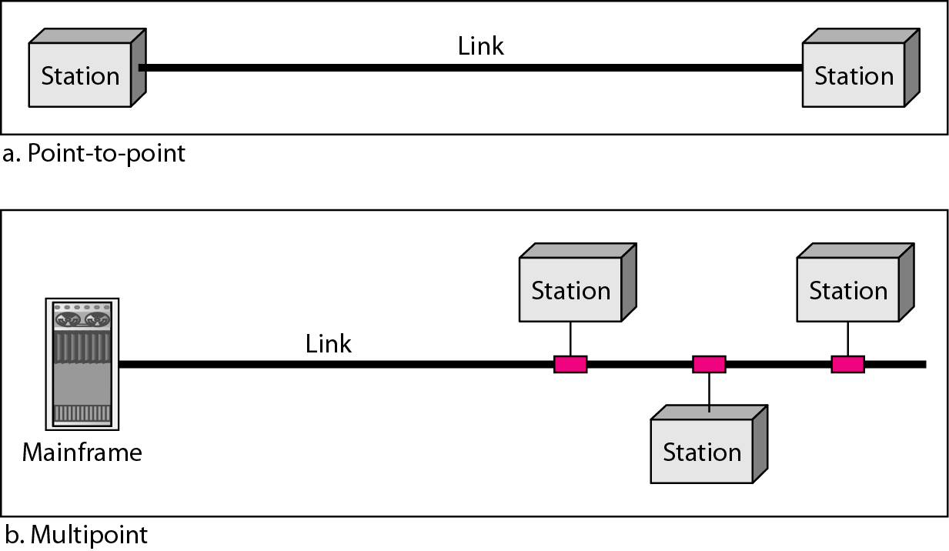
Physical Structures (3/4)
1: Based on the Type of Connection

Slide 33
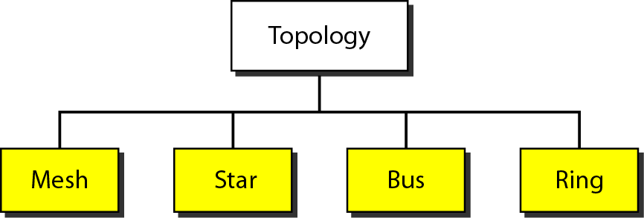
Physical Structures (4/4)
2: Based on the Type of Topology
Physical Topology refers to the way in which a network is laid out physically
Two or more devices connect to a link and two or more links form a topology
Topology is geometric representation of the relationship of all the links and nodes
(devices connected to one another through links)

Slide 34
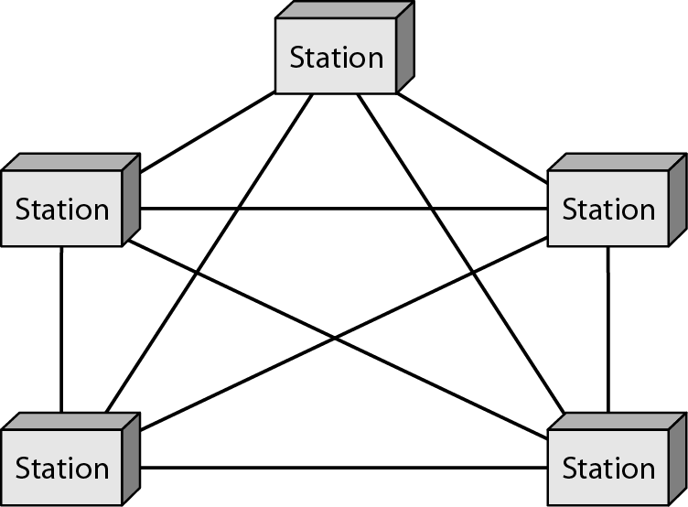
A fully connected mesh topology (five devices)
Example: Connection of telephone regional offices as each regional office needs to be connected with every other regional office

Slide 35
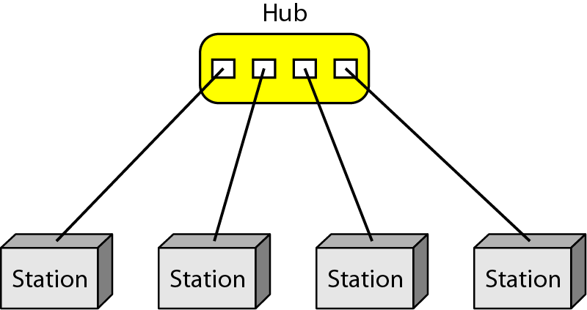
A star topology connecting four stations
Used in local area networks

Slide 36
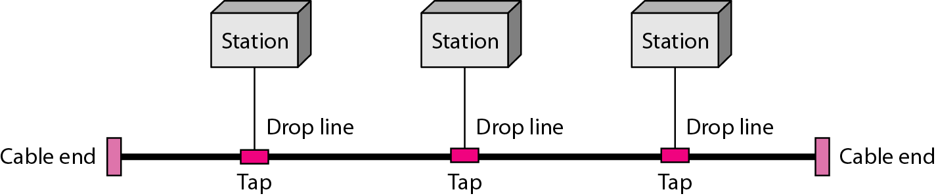
A bus topology connecting three stations
- Nodes are connected to the bus cable by drop lines and taps
- Was used in early LANs

Slide 37
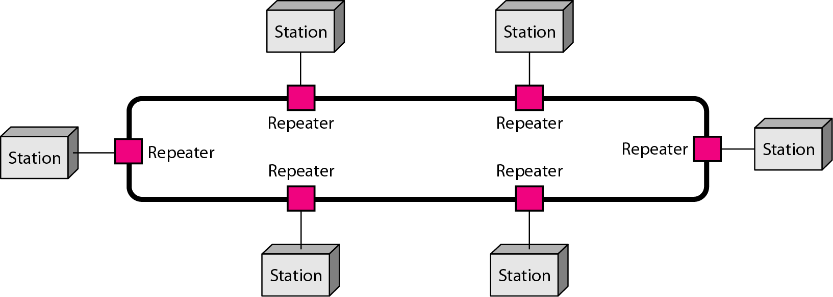
A ring topology connecting six stations
was used in LANs (Ethernet) introduced by IBM

Slide 38
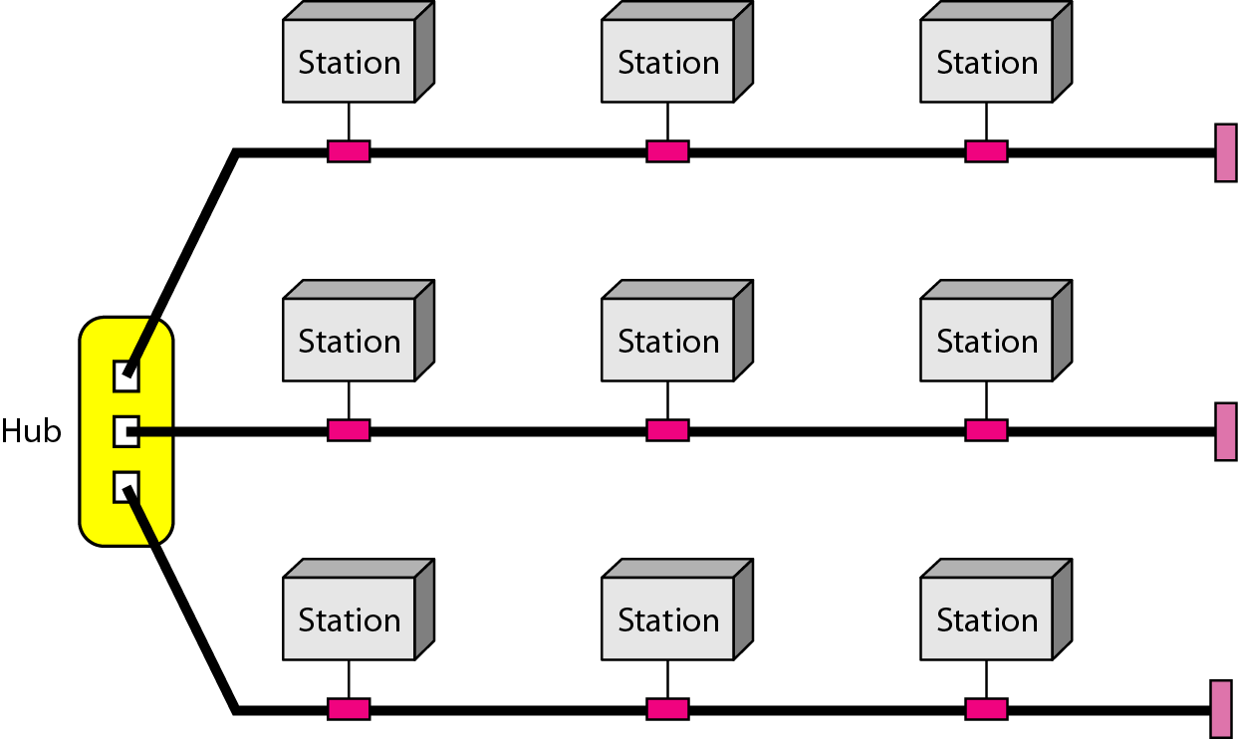
A hybrid topology:
a star backbone with three bus networks

Slide 39
Categories of Networks
Personal Area Networks (PANs)
Local Area Networks (LANs)
Metropolitan Area Networks
Wide Area Networks

Slide 40
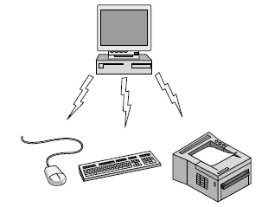
Personal Area Networks (PAN)
interconnection of information technology devices within the range of an individual person
generally within a range of 10 meters
Wireless PAN (Bluetooth) connecting a computer with its peripherals like mouse, printer, keyboard
Wired PAN (USB)
Bluetooth PAN configuration

Slide 41
Local Area Networks (LAN)
Local Area Networks (LANs)
Usually privately owned by the company using it
Operates within short distances like home, office, building, campus etc.
Designed to provide local interconnectivity
Connects hosts
Uses different transmission technologies like copper wires, optical fiber
Speed from 100 Mbps to 100 Gbps
Wireless LAN standard: IEEE 802.11 (WiFi)
Wired LAN standard: IEEE 802.3 (Ethernet)

Slide 42
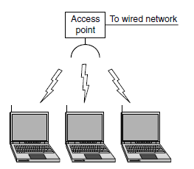
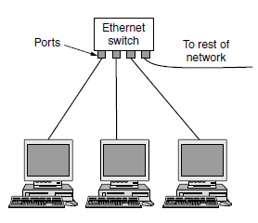
Local Area Networks (LAN)

Slide 43
Metropolitan Area Networks (MAN)
A network with a size between a LAN and a WAN
designed for customers
who need a high-speed connectivity, normally to the Internet, and
have endpoints spread over a city or part of city
usually based on LAN technology
Example: High speed wireless Internet access WiMAX (standardized as IEEE 802.16)
30 to 40 Mbps data rates, with updates to 1 Gbps

Slide 44
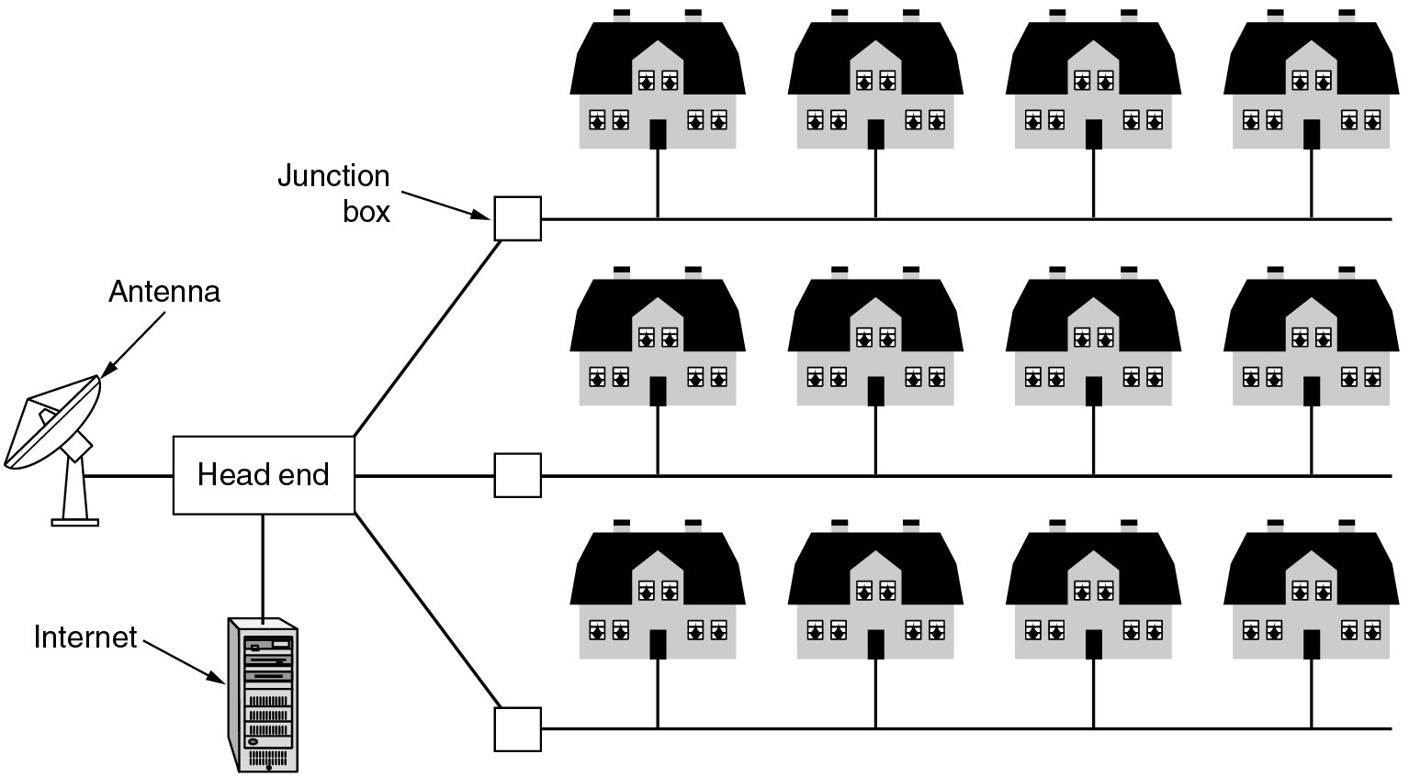
Metropolitan Area Networks (MAN)
Another Example: cable TV-based network
both television signals and Internet being fed into the centralized cable head-end
for subsequent distribution to people’s homes

Slide 45
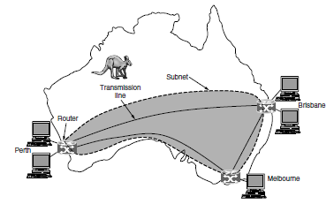
Wide Area Networks (WAN)
Long distances (may cover continent or planet)
Provide connectivity over large areas
Interconnects connecting devices such as switches, routers or modems
Create and run by communication companies
Leased by company that uses it
Wired WAN: A company with branch offices in different cities

